Slide 1
Lactic Acid
LC-MS, m/z:
88.9
LC-MS/MS, m/z:
71.0
18

Slide 2
Pipecolic acid
LC-MS, m/z:
128.0
LC-MS/MS, m/z:
82.0

Slide 3
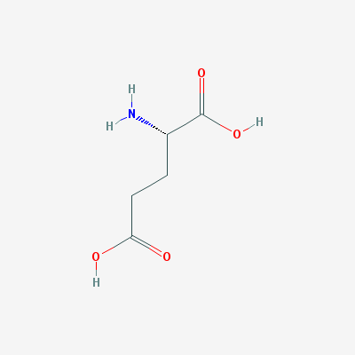
Glutamic acid
LC-MS, m/z:
146.2
LC-MS/MS, m/z:
84.9
102.0
128.1
26
18

Slide 4
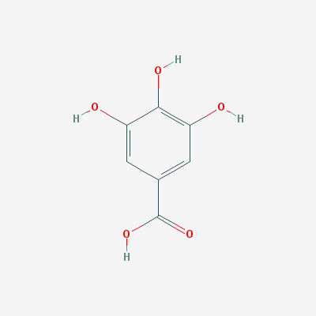
Gallic acid
LC-MS, m/z:
169.1
LC-MS/MS, m/z:
125.1

